Slide 1


LISTENING TO
DARK MATTER
AGAIN…

Slide 2
BUT...
WHY BOTHER?

Slide 3
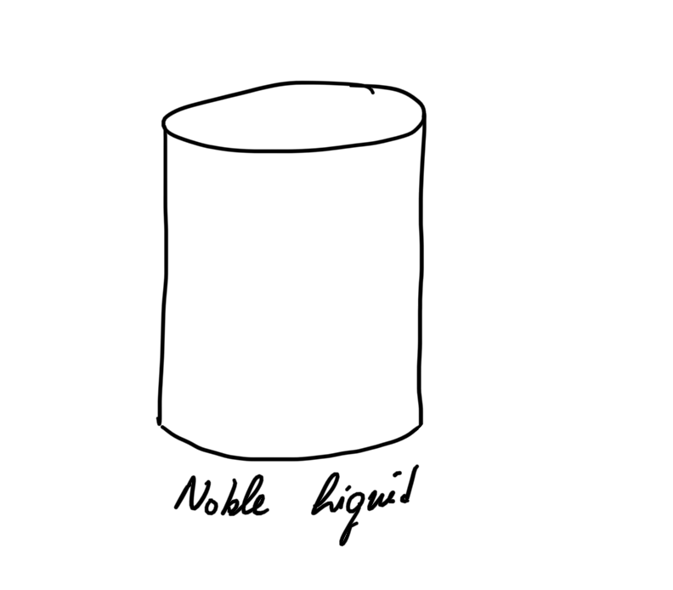
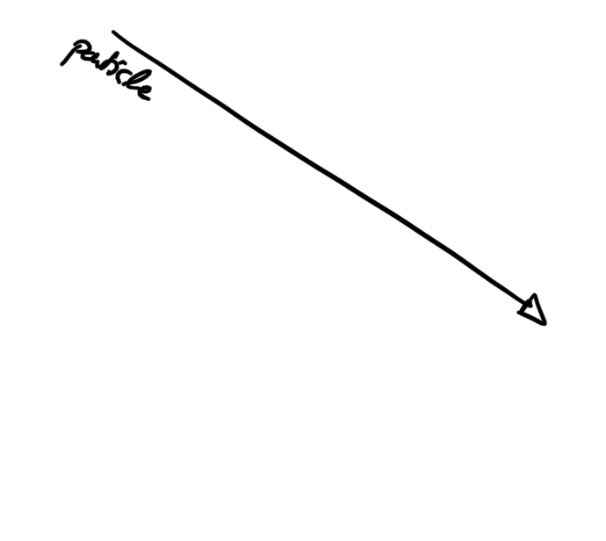
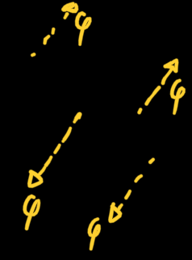
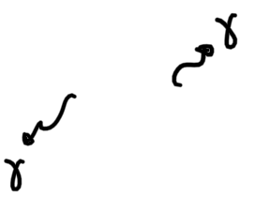


Slide 4
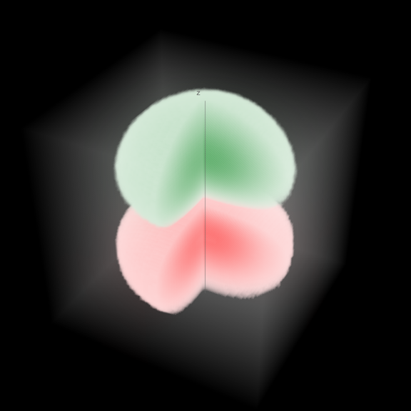






LAST TIME
CLASSICAL TREATMENT

Slide 5




THIS TIME
QUANTUM TREATMENT
EFFECTIVE
QFT
φ
Phonons
Particles of Sound

Slide 6



HOW DO WE
DESCRIBE PHONONS?

Slide 7







HOW DO WE GET A
LAGRANGIAN?
NAVIER – STOKES LAGRANGIAN
DERIVE AN EQUIVALENT
LAGRANGIAN
SYMMETRY

Slide 8

HOW DO WE
DESCRIBE DAMPING?
WE INCREASE
DEGREES OF FREEDOM

Slide 9

HOW DO WE GET A
LAGRANGIAN?
NAVIER – STOKES LAGRANGIAN
DERIVE AN EQUIVALENT
LAGRANGIAN
SYMMETRY

Slide 10

HOW DO WE GET A
LAGRANGIAN?

Slide 11
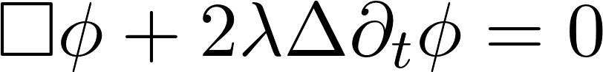
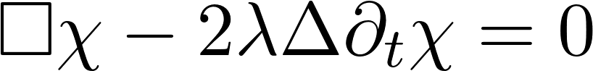
HOW DO WE GET A
LAGRANGIAN?
SECOND
QUANTIZATION

Slide 12
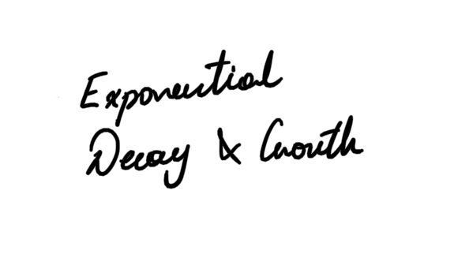
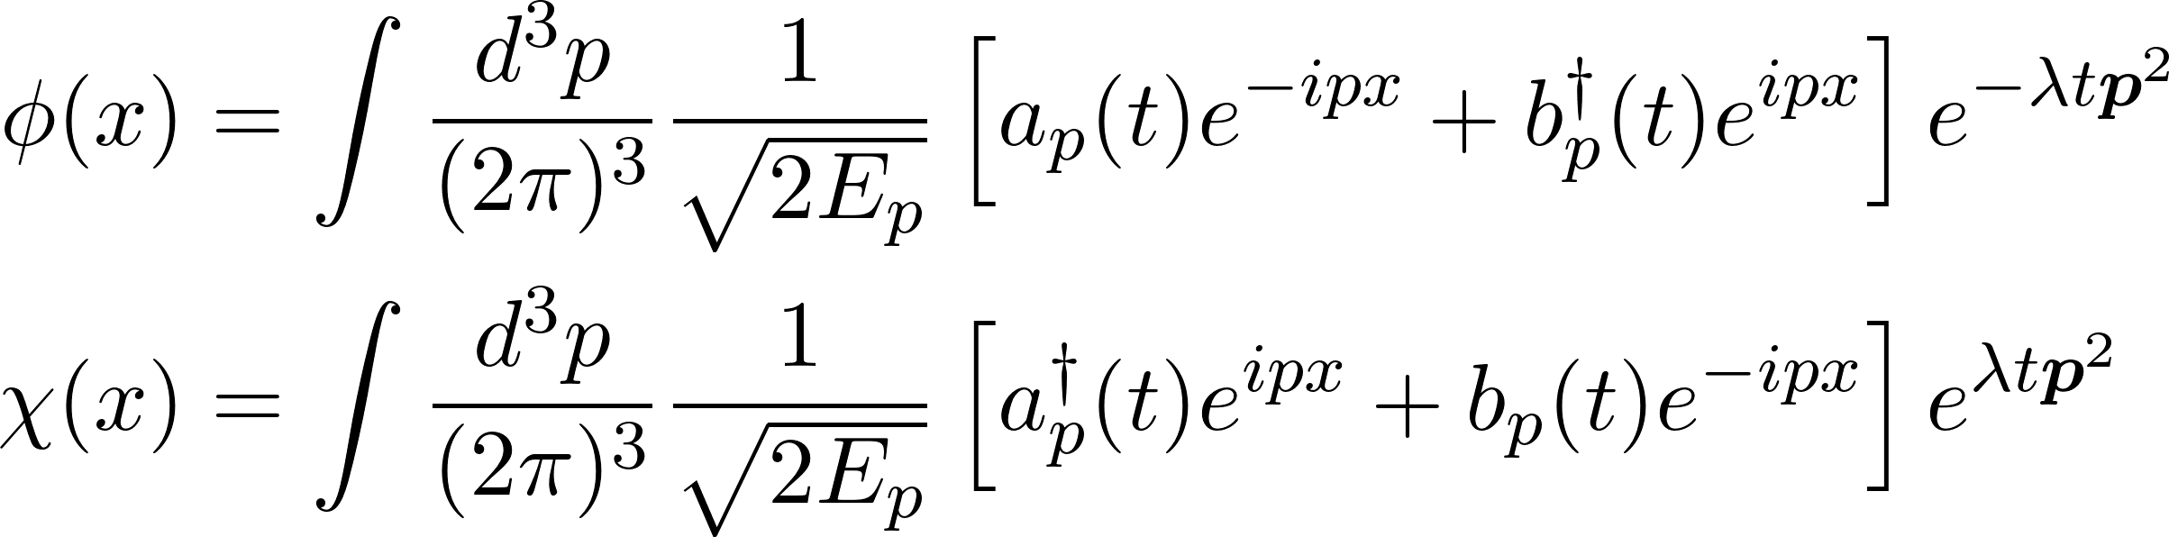
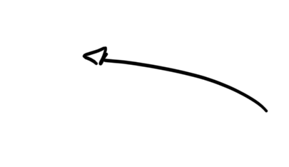


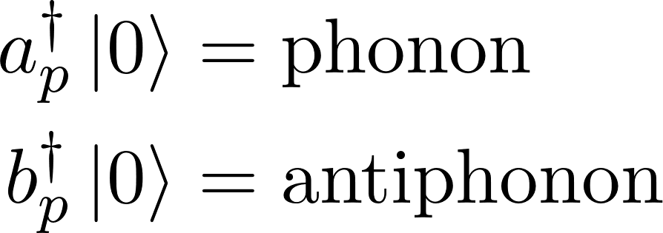
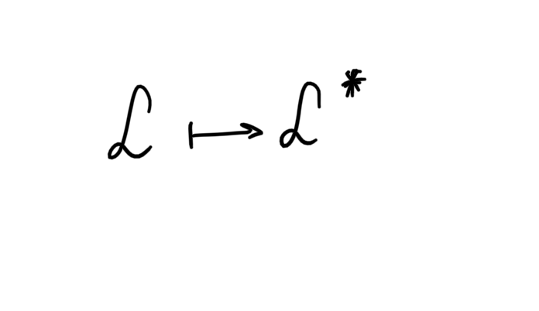
HOW DO WE
QUANTIZE?
CREATION & ANNIHILATION OPERATORS

Slide 13
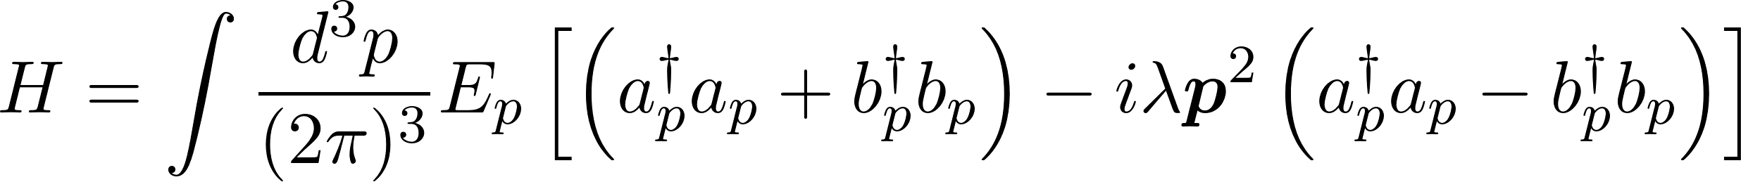


HOW DO WE
GET A HAMILTONIAN
Notes:
We have managed to create a theory of phonons and antiphonons that predicts damping nonperturbatively

Slide 14
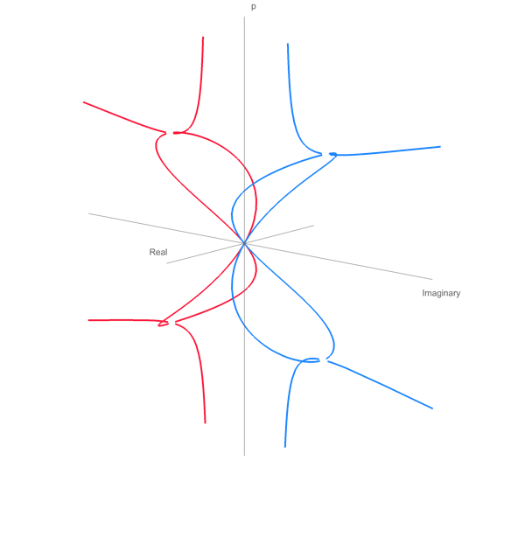
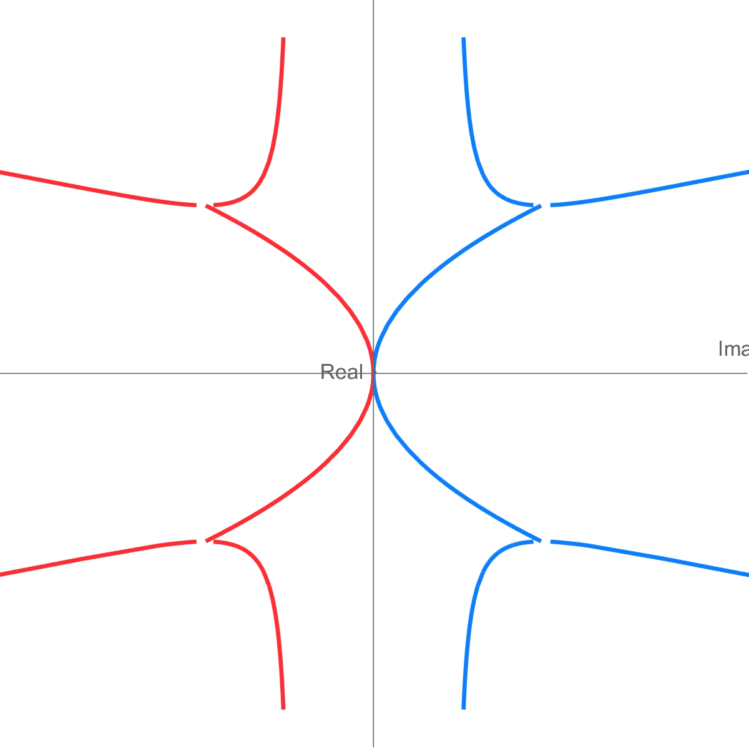


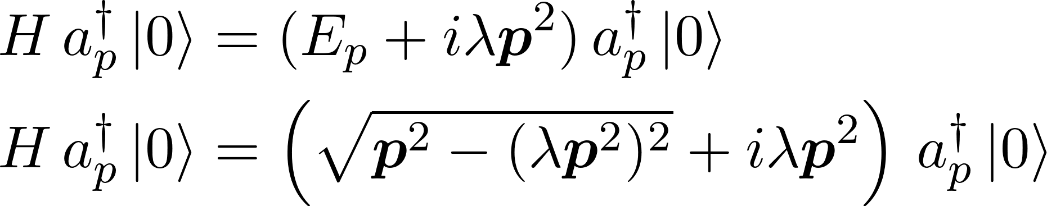

NO HERMITIAN
HAMILTONIAN?

Slide 15

HOW DO WE
GET A HAMILTONIAN

Slide 16



SUMMARY
EFFECTIVE QFT
WHY DO ALL THIS?
CAN WE USE SOUND TO SEARCH
FOR DARK MATTER WITH LIQUIDS?
* how much energy the particle
produces as sound
NON PERTURBATIVE QFT FOR STRONG DAMPING
PHONONS HAVE “MASS?”
2 PAPERS
QFT FORMALISM
CLASSICAL TREATMENT
Notes:
We have managed to create a theory of phonons and antiphonons that predicts damping nonperturbatively

Slide 17
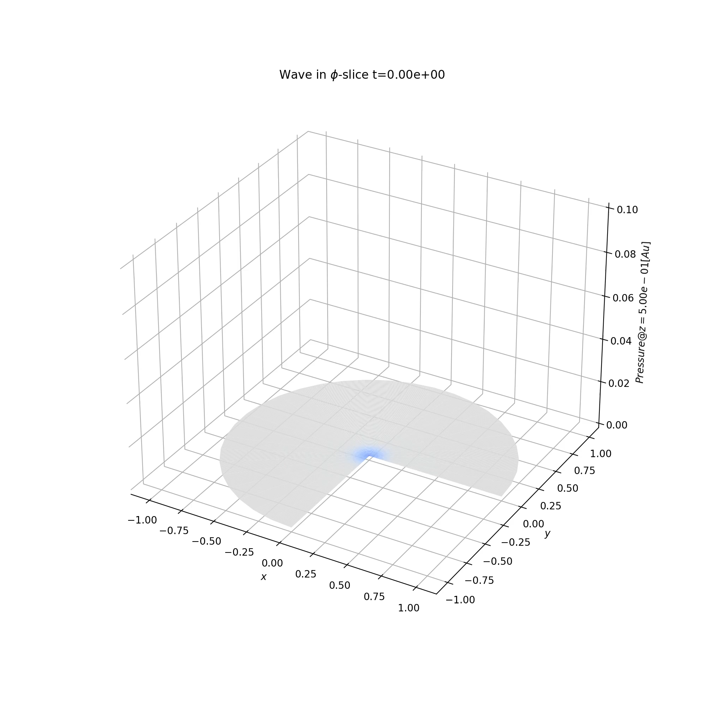
ACKNOWLEDGMENTS
Professor Francesco Arneodo (NYUAD)
Dr. Laura Manenti (NYUAD)
Professor John Learned (UHM)
Dr. Mario Motta (CALTECH)
Professor Sergei Dubovsky (NYU)
Professor Johnathan Goodman (NYU)
Professor Elena Beretta (NYUAD)
Professor Francesco Paparella (NYUAD)
Dr. Lucas Sletten (UCB)

Slide 18
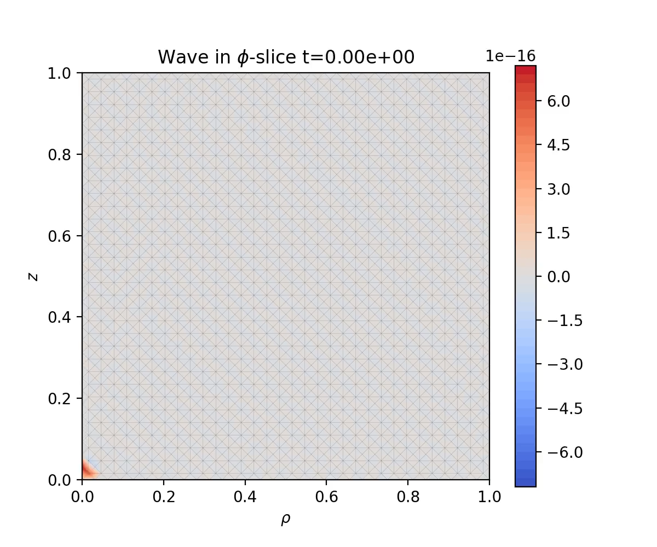
NUMERICAL ESTIMATION
WHAT’S TO COME
QUESTIONS?

